Slide 1
BOOTSTRAP

Slide 2
What is Bootstrap?
Bootstrap is a free, open-source and is the most popular HTML, CSS, and JavaScript framework developed by twitter for creating responsive web applications.
It can be used to create a web application built with any server side technologies like ASP.NET, JAVA, PHP etc.

Slide 3
History
Bootstrap was developed by Mark Otto and Jacob Thornton at Twitter (Twitter Blueprint). It was released as an open source product in August 2011 on GitHub.
Version 2.0 supports Responsive web design.
Version 3.0 adopted a mobile- first design.
Version 4.0 alpha added Sass and Flexbox support.

Slide 4

Why use Bootstrap?
Mobile first approach:
The framework consists of Mobile first styles throughout the entire library instead of in separate files.
Browser Support:
It is supported by all popular browsers.
Easy to get started:
With just the knowledge of HTML and CSS anyone can get started with Bootstrap.
Responsive design:
Bootstrap's responsive CSS adjusts to Desktops, Tablets and Mobiles.

Slide 5
What Bootstrap Package Includes?
Scaffolding: Bootstrap provides a basic structure with Grid System, link styles, background.
CSS: Bootstrap comes with feature of global CSS settings, fundamental HTML elements and enhanced with extensible classes, and an advanced grid system.
Components: Bootstrap contains over a dozen reusable components built to provide iconography, dropdowns, navigation, alerts, popovers, and much more.

Slide 6
What Bootstrap Package Includes?
JavaScript Plugins: Bootstrap contains a variety of customized jQuery plugins. We can easily include them all, or one by one.
Customize: We can customize Bootstrap's components and jQuery plugins to get your very own version.
Download Bootstrap
You can download the http://getbootstrap.com/.
latest
version
of Bootstrap
from

Slide 7
Bootstrap CDN Links
•
•
<!-- Latest compiled and minified CSS -->
<link rel="stylesheet" href="https://maxcdn.bootstrapcdn.com/bootstrap/3.3.7/css/bootstrap.min.css" integrity="sha384- BVYiiSIFeK1dGmJRAkycuHAHRg32OmUcww7on3RYdg4Va+PmSTsz/K68vbdEjh4u" crossorigin="anonymous">
•
•
<!-- Optional theme -->
<link rel="stylesheet" href="https://maxcdn.bootstrapcdn.com/bootstrap/3.3.7/css/bootstrap- theme.min.css" integrity="sha384- rHyoN1iRsVXV4nD0JutlnGaslCJuC7uwjduW9SVrLvRYooPp2bWYgmgJQIXwl/Sp" crossorigin="anonymous">
•
•
<!-- Latest compiled and minified JavaScript -->
<script src="https://maxcdn.bootstrapcdn.com/bootstrap/3.3.7/js/bootstrap.min.js" integrity="sha384- Tc5IQib027qvyjSMfHjOMaLkfuWVxZxUPnCJA7l2mCWNIpG9mGCD8wGNIcPD7Txa" crossorigin="anonymous"></script>

Slide 8
Download Bootstrap
Original source files are included as listed below.
Jquery.js
Bootstrap.min.css
Bootstrap.js
Example:
<script type="text/javascript" src="js/jquery-3.1.1.js"></script>
<script type="text/javascript" src="lib/bootstrap/js/bootstrap.js"></script>
<link rel="stylesheet" type="text/css" href="lib/bootstrap/css/bootstrap.css">

Slide 9
Containers
.container class used for a responsive fixed-width.
Syntax:
<div class="container">
…..
</div>
.container-fluid for a full-width container.
Syntax:
<div class="container-fluid">
...
</div>

Slide 10
What is a Grid?
Grid is a structure (usually two-dimensional) made up of a series of intersecting straight (vertical, horizontal) lines used to structure the content.
In web design, it is a very effective method to create a consistent layout rapidly and effectively using HTML and CSS.
It organize and structure content, makes the websites easy to scan and reduces the load on users.

Slide 11
Grid System Description
Grid System consists of 12 columns.
The Grid system is used for creating page layouts through a series of rows and columns.
Rows must be placed with a .container (fixed –width) or
.container –fluid (full-width) for proper alignment and padding.
Use rows to create horizontal group of columns.
Content should be placed within columns, and only columns may be immediate children of rows.

Slide 12
Grid System Structure
col-*-1
col-*-1
col-*-1
col-*-1
col-*-1
col-*-1
col-*-1
col-*-1
col-*-1
col-*-1
col-*-1
col-*-1
col- * - 6
col-*-6
col- * - 4
col- * - 4
col- * - 4
col- * - 4
col- * - 8
col- * - 12

Slide 13
Working of Bootstrap Grid System
Grid systems are used for creating page layouts through a series of rows and columns that house your content.
Here's how the Bootstrap grid system works:
Rows must be placed within a .container class for proper alignment and padding.
Use rows to create horizontal groups of columns.
Content should be placed within columns, and only columns may be immediate children of rows.
Predefined grid classes like .row and .col-*-* are available for quickly making grid layouts.
Columns create gutters (gaps between column content) via padding. That padding is offset in rows for the first and last column via negative margin on .rows.
Grid columns are created by specifying the number of twelve available columns you wish to span.
If more than 12 columns are placed within a single row, each group of extra columns wrap onto a new line.

Slide 14
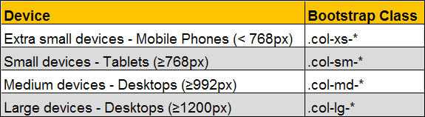
Grid Classes
The Bootstrap grid system has four classes:
xs (for phones)
sm (for tablets)
md (for desktops)
lg (for larger desktops)

Slide 15
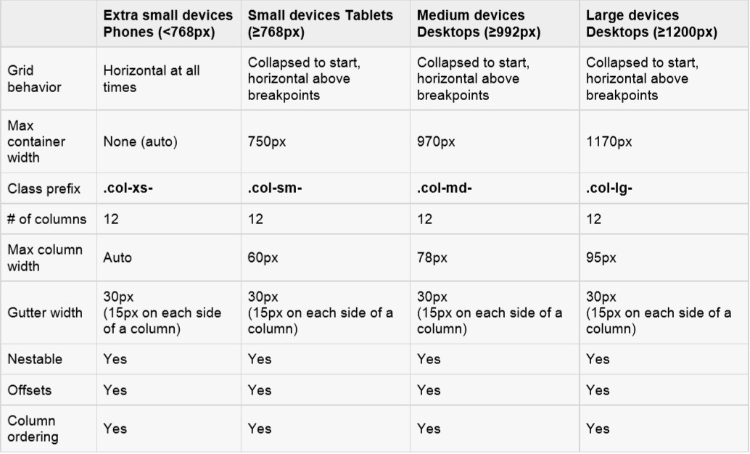
Grid options
The following table summarizes aspects of how Bootstrap grid system works across multiple devices:

Slide 16
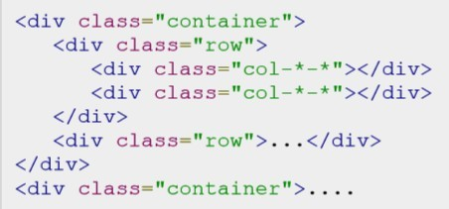
BASIC GRID STRUCTURE
Following is basic structure of Bootstrap grid:

Slide 17
BASIC GRID STRUCTURE
Let us see some simple grid examples:
Example: Stacked-to-horizontal
Example: Medium and Large Device
Example: Mobile, tablet, desktops

Slide 18
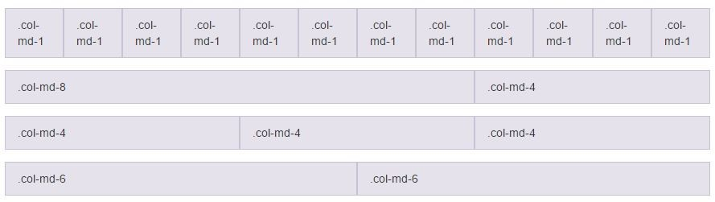
Bootstrap Grid System Example: Stacked-to-horizontal

Slide 19
Stacked-to-horizontal
Container class is added to ensure the proper centering and maximum width of the layout.
Once container is added, we need to think in terms of rows. Add <div class = "row">...</div> and
columns <div class = "col-md-6"></div> inside the rows
In the example we have two columns each made of 6 units wide.(6+6 =12).

Slide 20
Bootstrap Grid System Example: Medium and Large Device
Here we have used md and lg column groups for support of medium and large size devices.
For medium size devices, 2 div’s will go from 50% by 50% of split.
For large size devices, 2 div’s will go form 33% by 66% of spilt.

Slide 21
Bootstrap Grid System Example: Mobile, Tablet, Desktops
Now this gives us 3 different column layouts <div class="container">
On a phone, it will be 25% on the left, and 75% on the right.
On a tablet, it will be 50%/50% again,
Large viewport, it will be 33%/66%.
3 different layouts for each of the 3 responsive sizes.

Slide 22
Column Wrapping
More than 12 columns are placed within a single row, Each group of extra columns will wrap onto a new line.

Slide 23
Responsive column resets
Assume that four tiers of grids available, we run into issues where at certain breakpoints.
Columns are don’t clear quite right as one is taller than the other.
To fix this issue, We can use class .clearfix.

Slide 24
Offsetting columns
It can be used for push columns over for more spacing.
.col-md-offset-* class increases the left margin of a column range form 1 to 11.
Offset class moves the content to the right depending upon the given value.

Slide 25
Nesting columns
To nest your content with the default grid, add a
new row and set of columns within an existing column.
Nested rows should include a set of columns that add up to 12.

Slide 26
Column Ordering
To write columns in an order and show them in one another one by using push and pull modifier classes where ranges form 1 to 11.
Syntax:
.col-md-push-*
.col-md-pull-*

Slide 27
Typography
Bootstrap uses Helvetica Neue, Helvetica, Arial, and sans-serif in its default font stack. Using typography feature of Bootstrap you can create headings, paragraphs, lists and other inline elements.
Default font-size is 14px. with a line –height of 1.428.(Applied to <body> and all paragraphs).
Paragraph <p> elements have a bottom margin that equals half their computed line- height (10px by default).
•
•
Headings:
All HTML headings (h1 to h6) are styled in Bootstrap. An example is as shown below:
<h1>I'm Heading1 h1</h1> Semibold 36px
<h2>I'm Heading2 h2</h2> Semibold 30px
<h3>I'm Heading3 h3</h3> Semibold 24px
<h4>I'm Heading4 h4</h4> Semibold 18px
<h5>I'm Heading5 h5</h5> Semibold 14px
<h6>I'm Heading6 h6</h6> Semibold 12px

Slide 28
Typography
INLINE SUBHEADINGS:
To add an inline subheading to any of the headings, simply add <small> around any of the elements or add .small class and you will get smaller text in a lighter color as shown in the example below:
<h1>I'm Heading1 h1. <small>I'm secondary Heading1 h1</small></h1>
<h2>I'm Heading2 h2. <small>I'm secondary Heading2 h2</small></h2>
<h3>I'm Heading3 h3. <small>I'm secondary Heading3 h3</small></h3>
<h4>I'm Heading4 h4. <small>I'm secondary Heading4 h4</small></h4>
<h5>I'm Heading5 h5. <small>I'm secondary Heading5 h5</small></h5>
<h6>I'm Heading6 h6. <small>I'm secondary Heading1 h6</small></h6>

Slide 29
Inline text elements
Marked Text: Highlight the text using <mark> tag.
Deleted Text: Blocks of text have been deleted using <del> tag.
Strikethrough Text: Blocks of text that are no longer relevant using the <s> tag.
Inserted text: The <ins> tag defines a text that has been inserted into a document.
Underline Text: The <u>tag defines a underline text.
Small Text: Use the <small> tag to set the text at 85% the size of the parent.
Bold: Text with a heavier font-weight can be done by <strong> tag.
Italics: For Emphasizing of text with italics done by <em> tag.

Slide 30
Alignment classes
Realign text can be done with text alignment classes.
text-left class used for Left aligned text.
text-right class used for Right aligned text.
text-center class used for Center aligned text.
text-justify class used for Justified text.
text-nowrap class used for No wrap text.

Slide 31
Transformation classes
Transform text by using text capitalization classes.
text-lowercase class used for Lowercased text.
text-uppercase class used for Uppercased text.
text-capitalize class used for Capitalized text.

Slide 32
Abbreviations
Basic Abbreviation :An abbreviation of the word attribute is attr.
Syntax :<abbr title="attribute">attr</abbr>
Initialism: Add .Initialism to an abbreviation for a slightly smaller font-size.
Syntax :<abbr title="HyperText Markup Language" class="initialism">HTML</abbr>
Addresses
To represent contact information by using <address> tag. Syntax : <address>……. </address>

Slide 33
Blockquotes
`
Blocks of content from another source within your document.
Default blockquote
The blockquote element is used to present content from another source using <p> tag.
Block quote options
Naming a source : Style and content changes for simple variations on a standard <bolckquote>.Add a <footer> for identifying the source.
Alternate Displays:Add .bolckquote-reverse class right –aligned content.
Syntax:<blockquote class="blockquote-reverse">
...</blockquote>

Slide 34
Lists
Unordered :A list of items in which the order does not explicitly matter.
Syntax : <ul>
<li>...</li>
</ul>
Ordered :A list of items in which the order does explicitly matter.
Syntax : <ol>
<li>...</li>
</ol>
Unstyled: Removes the Default list-style and left margin for list items. It only applies to immediate children of list items.
Syntax:<ul class="list-unstyled">
<li>...</li>
</ul>
•
•

Slide 35
•
Inline: Place all list items on a single line with padding. Syntax :<ul class="list-inline">
<li>...</li>
</ul>
Description: A list of terms with their associated descriptions. Syntax:<dl>
<dt>...</dt>
<dd>...</dd>
</dl>
Horizontal description Syntax:<dl class="dl-horizontal">
<dt>...</dt>
<dd>...</dd>
</dl>
•

Slide 36
Tables
Basic Table:
If you want a nice, basic table style with just some light padding and horizontal dividers, add the base class of .table to any table .
Syntax:
<table class="table">
…………..
</table>

Slide 37
Tables
STRIPED TABLE :
By adding the .table-striped class, you will get zebra-striping to any rows within the <tbody>.
Syntax:
<table class="table table-striped">
…………
</table>

Slide 38
Tables
BORDERED TABLE :
By adding the .table-bordered class, you will get borders surrounding every element and rounded corners around the entire table.
Syntax:
<table class="table table-bordered">
………….
</table>

Slide 39
Tables
HOVER TABLE :
By adding the .table-hover class, a light gray background will be added to rows while the cursor hovers over them.
Syntax:
<table class="table table-hover">
…………….
</table>

Slide 40
Tables
Condensed table
By adding the . table-condensed class, to make tables more compat by cutting cell padding in half.
Syntax:
<table class="table table-condensed">
…………….
</table>

Slide 41
Contextual classes
Use contextual classes to color table rows or individual cells.
Class
Description
Applies the hover color to a particular row or cell
Indicates a successful or positive action
Indicates a neutral informative change or action
Indicates a warning that might need attention
Indicates a dangerous or potentially negative action
.active
.success
.info
.warning
.danger

Slide 42
Tables
RESPONSIVE TABLES:
By wrapping any .table in .table-responsive class, you will make the table scroll horizontally up to small devices (under 768px). When viewing on anything larger than 768px wide, you will not see any difference in these tables.
Syntax:
<div class="table-responsive">
<table class="table">
………….
</table>
</div>

Slide 43
Forms
Form controls automatically receive some global styling with Bootstrap:
All Textual <input>, <textarea>, and <select> elements with class .form-control have a width of 100%.
Form Layouts:
Bootstrap provides you with following types of form layouts:
Vertical (default) form
Inline form
Horizontal form

Slide 44
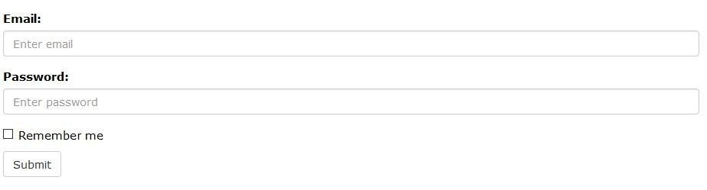
Forms
VERTICAL( OR BASIC) FORM:
Add a role form to the parent <form> element.
Wrap labels and controls in a <div> with class .form-group. This is needed for optimum spacing.
Add a class of .form-control to all textual <input>,
<textarea>, and <select> elements.

Slide 45
Forms
INLINE FORM :
To create a form where all of the elements are inline, left aligned and labels are alongside, add the class
.forminline to the <form> tag.
Note: This only applies to forms within viewports that are at least 768px wide!

Slide 46
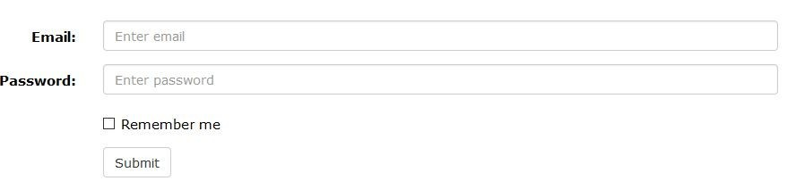
Forms
HORIZONTAL FORM:
Add a class of .form-horizontal to the parent <form> element.
Add a class of .control-label to all <labels> elements.

Slide 47
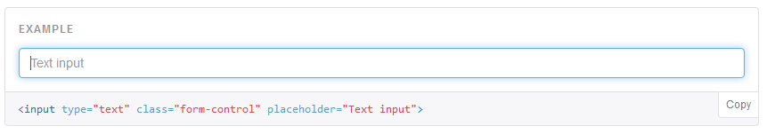
Supported controls
Inputs: Bootstrap supports all the HTML5 input types: text, password, datetime, datetime-local, date, month, time, week, number, email, url, search, tel, and color.
Inputs will be fully styled if type is properly declared.
•
•
Textarea : Form control supports multiples lines of text. Change rows attribute as required.
Checkboxes and Radio Buttons: Checkboxes or Radiobuttons are used if you want the user to select any number of options from a list of preset options.
•

Slide 48
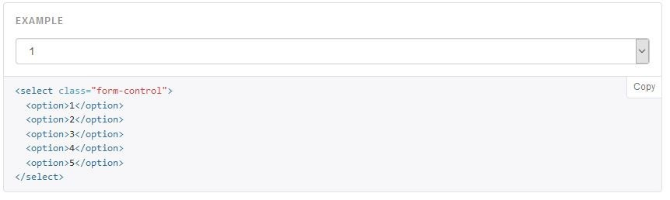
.checkbox /.radio - Default (stacked orientation).
.checkbox - inline /.radio - inline - Controls are appear on the same line.
.disabled – Disable the input.
Selects:
Single select form no.of options

Slide 49
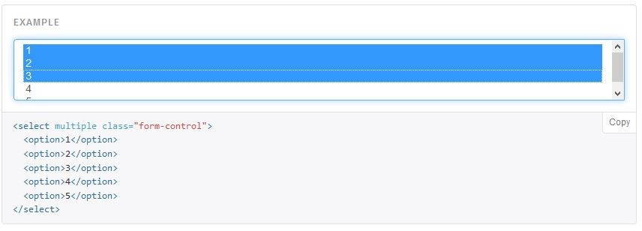
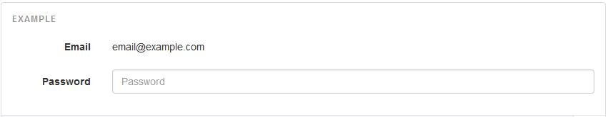
Select lists that are allow the user to pick from multiple options.
Static Control :If you need to insert plain text next to a form label within a horizontal form, use the .form-control-static class on <p> element.

Slide 50
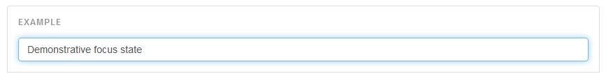
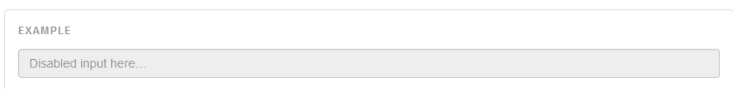
Focus state : We remove the default outline styles on some form controls and apply a box- shadow in its place for :focus.
•
Disabled state: Add the disabled Boolean attribute to an input. Disabled inputs appear lighter and add a not-allowed cursor.
Syntax:<input class="form-control" id="disabledInput" type="text" placeholder="Disabled input here..." disabled>

Slide 51
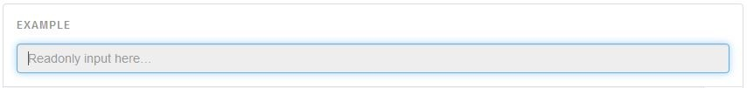
•
Readonly state: add the readonly Boolean attribute on an input to prevent modification of the input’s value. Read-only inputs appear lighter (just like disabled inputs), but retain the standard cursor.
Syntax:<input class="form-control" type="text" placeholder="Readonly input here…" readonly>
Help Text : A block of help text that breaks onto a new line and may extend beyond one line.
Syntax:<label class="sr-only" for="inputHelpBlock">Input with help text</label>
<input type="text" id="inputHelpBlock" class="form-control" aria- describedby="helpBlock">.

Slide 52
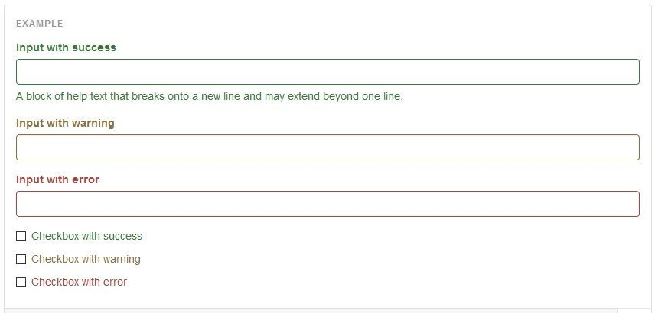
Validation states
Bootstrap includes validation styles for error, warning, and success states on form controls. To use, add .has-warning, .has-error, or .has-success to the parent element. Any .control-label, .form-control, and .help-block within that element will receive the validation styles.

Slide 53
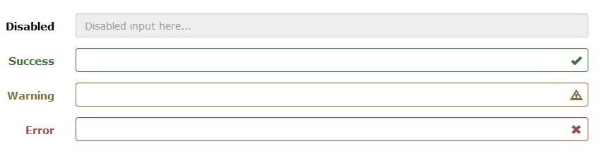
Bootstrap Form Control States
INPUT FOCUS - The outline of the input is removed and a box-shadow is applied on focus
DISABLED INPUTS - Add a disabled attribute to disable an input field
DISABLED FIELDSETS - Add a disabled attribute to a fieldset to disable all controls within
READONLY INPUTS - Add a readonly attribute to an input to prevent user input
VALIDATION STATES - Bootstrap includes validation styles for error, warning, and success messages. To use, add .has-warning, .has-error, or .has-success to the parent element
ICONS - You can add feedback icons with the .has-feedback class and an icon
HIDDEN LABELS - Add a .sr-only class on non-visible labels

Slide 54
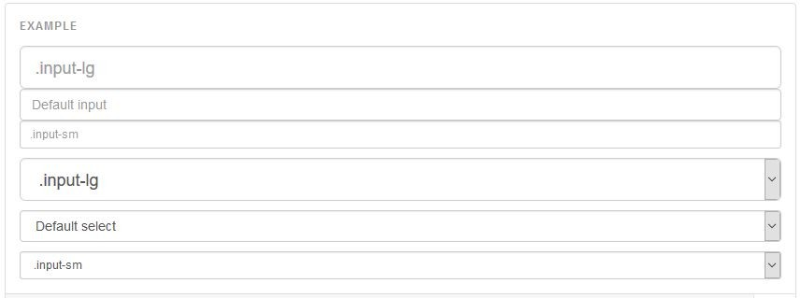
Control sizing
Set the heights of the input elements using classes likes .input-lg and .input-sm.
Set the widths of elements using grid column classes like .col-lg-
* and .col-sm-*.
Height Sizing

Slide 55
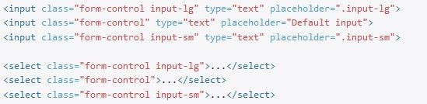
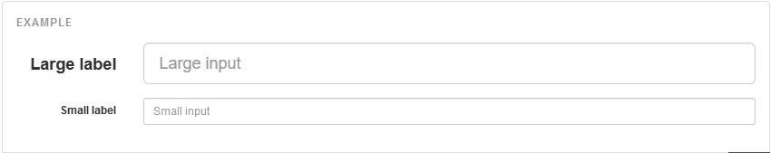
Syntax:
Horizontal form group sizes:
Quickly size labels and form controls within .form-horizontal by adding .form-group-lg or .form-group-sm.

Slide 56
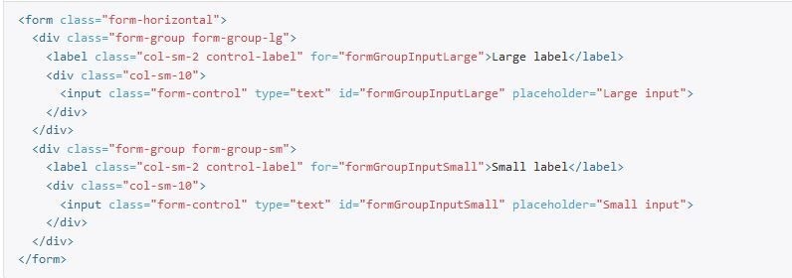
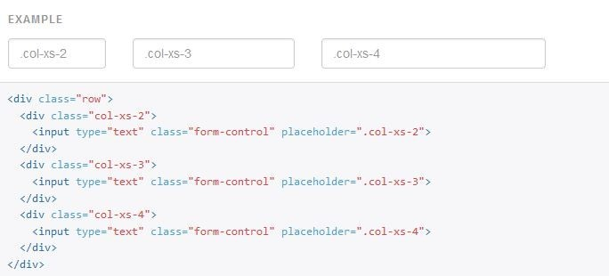
Syntax:
Column sizing: Wrap inputs in grid columns, or any custom parent element, to easily enforce desired widths.
Syntax:

Slide 57
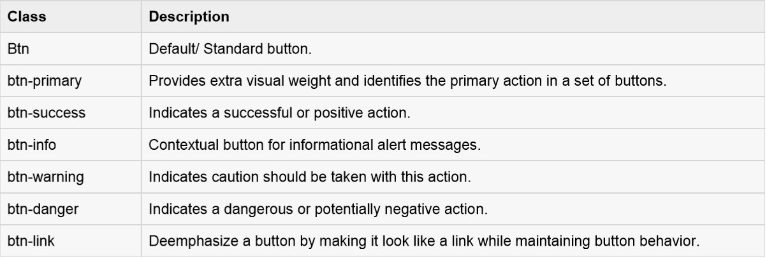
Buttons
Here we will discuss about how to use Bootstrap button with examples. Anything that is given a class of .btn will inherit the default look of a gray button with rounded corners.

Slide 58
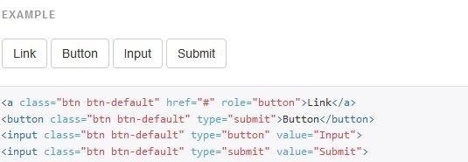

Buttons
Button Tags
The button classes used as <a> ,<button> or <input> element.
Example :
Syntax:
<a class="btn btn-default" href="#" role="button">Link</a>
<button class="btn btn-default" type="submit">Button</button>
<input class="btn btn-default" type="button" value="Input">
<input class="btn btn-default" type="submit" value="Submit">

Slide 59
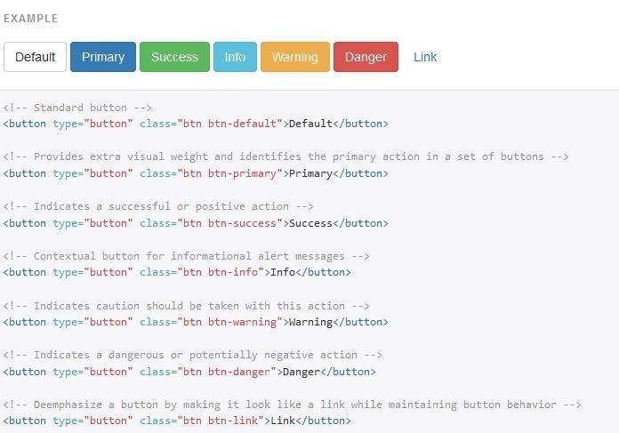
Button Options
Bootstrap provides seven styles of buttons:

Slide 60
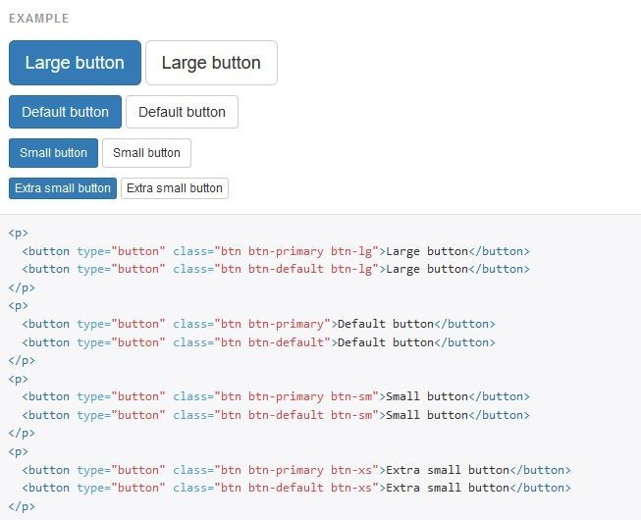
Button Sizes
The classes that define the different sizes are:
.btn-lg
.btn-md
.btn-sm
.btn-xs

Slide 61
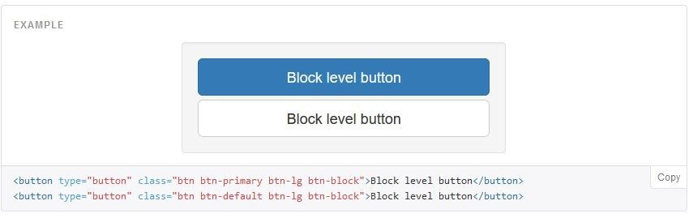
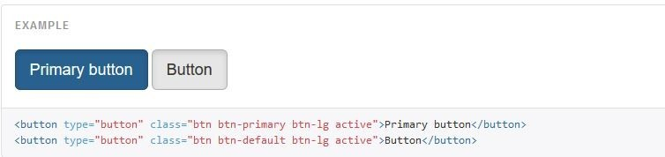
Create block level buttons—those that span the full width of a parent— by adding .btn-block.
Active state:
Buttons will appear pressed (with a darker background, darker border, and inset shadow) when active.
For <button> elements, this can be done by .active class.

Slide 62
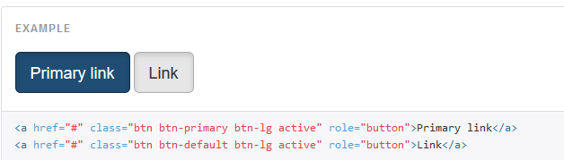
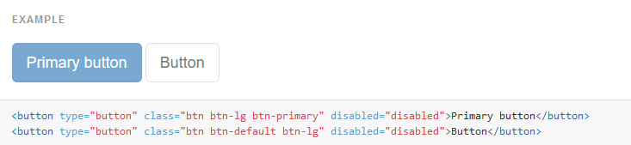
Anchor element:
Add the .active class to <a> button.
Disabled state: Make buttons look unclickable by fading them back with opacity.
Add the disabled attribute to the <button> buttons.

Slide 63
Images
Bootstrap provides three classes that can be used to apply some simple styles to images:
.img-rounded: class adds rounded corners to an image (IE8 does not support rounded corners)
.img-circle: class shapes the image to a circle (IE8 does not support rounded corners):
.img-thumbnail: class shapes the image to a thumbnail.

Slide 64
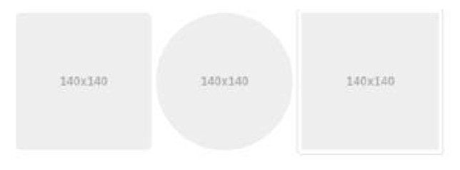
Syntax:
<img src="..." alt="..." class="img-rounded">
<img src="..." alt="..." class="img-circle">
<img src="..." alt="..." class="img-thumbnail">
OUTPUT:

Slide 65
Responsive Images
Images come in all sizes. So do screens. Responsive images automatically adjust to fit the size of the screen.
Create responsive images by adding an .img-responsive class to the
<img> tag. The image will then scale nicely to the parent element.
The .img-responsive class applies display: block; and max-width: 100%; and height: auto; to the image:
•
•
Syntax :
<img src="..." class="img-responsive" alt="Responsive image">

Slide 66
Helper classes
•
•
Add meaning through text-colors with the classes Example :
Bootstrap Programming. Bootstrap Programming. Bootstrap Programming. Bootstrap Programming. Bootstrap Programming. Bootstrap Programming.
Syntax:
<p class="text-muted">...</p>
<p class="text-primary">...</p>
<p class="text-success">...</p>
<p class="text-info">...</p>
<p class="text-warning">...</p>
<p class="text-danger">...</p>

Slide 67
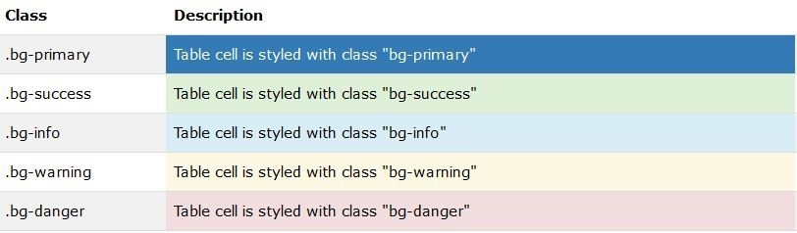
Contextual backgrounds
Add meaning through background-colors with the classes below. Links will darken on hover just like text classes:
Syntax:
<p class="bg-primary">...</p>
<p class="bg-success">...</p>
<p class="bg-info">...</p>
<p class="bg-warning">...</p>
<p class="bg-danger">...</p>

Slide 68
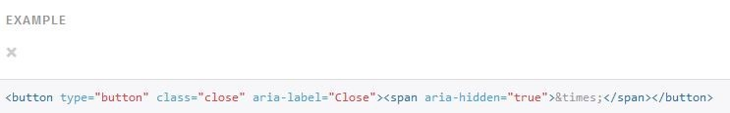
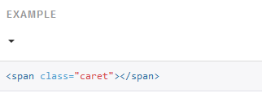
Close icon :
Use the generic close icon for dismissing content like modals and alerts. Use the class close to get the close icon.
Carets:
Use carets to indicate dropdown functionality and direction. To get this functionality use the class caret with a
<span> element.

Slide 69
Quick floats
Float an element to the left or right with a class. Syntax :<div class="pull-left">...</div>
<div class="pull-right">...</div>
Center content blocks: Sets an element to display:block and center with margin-right:auto and margin-left:auto.
Syntax :<div class="center-block">...</div>
Showing and hiding content:
.show class Forces an element to be shown (display:block)
.hidden class Forces an element to be hidden (display:none) Syntax:<div class="show">...</div>
<div class="hidden">...</div>

Slide 70
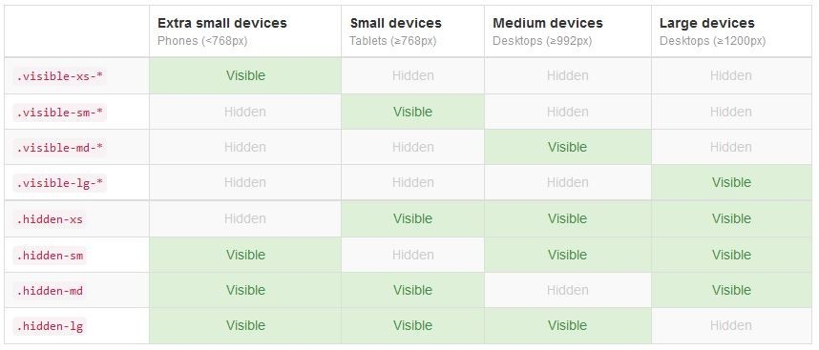
Responsive utilities
These classes are used to show and/or hide content by device via media queries.
Available classes :
Use one or a combination of the available classes for toggling content across viewport breakpoints.

Slide 71
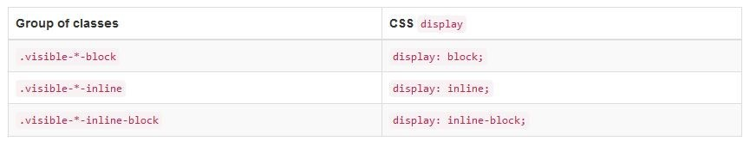
As of v3.2.0, the .visible-*-* classes for each breakpoint come in three variations, one for each CSS display property value listed below.
E.g. for small (sm) screens, the available .visible-*-* classes are:
.visible-sm-block, .visible-sm-inline, and .visible-sm-inline-block.
The classes .visible-xs, .visible-sm, .visible-md, and .visible-lg are deprecated as of v3.2.0. They are approximately equivalent to
.visible-*-block

